Slide 1

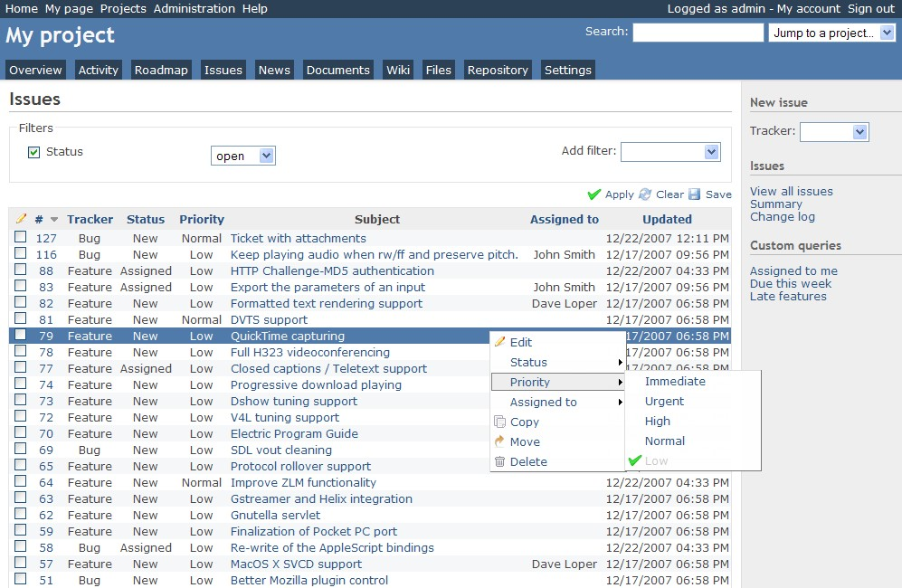
Redmine
Redmine is a free and open source, web-based project management and issue tracking tool.

Slide 2
Redmine
Redmine
Ruby
Rails
MySQL / PostgreSQL /Microsoft SQL /SQLite
Unix / Linux / macOS / macOS Server / Windows

Slide 3
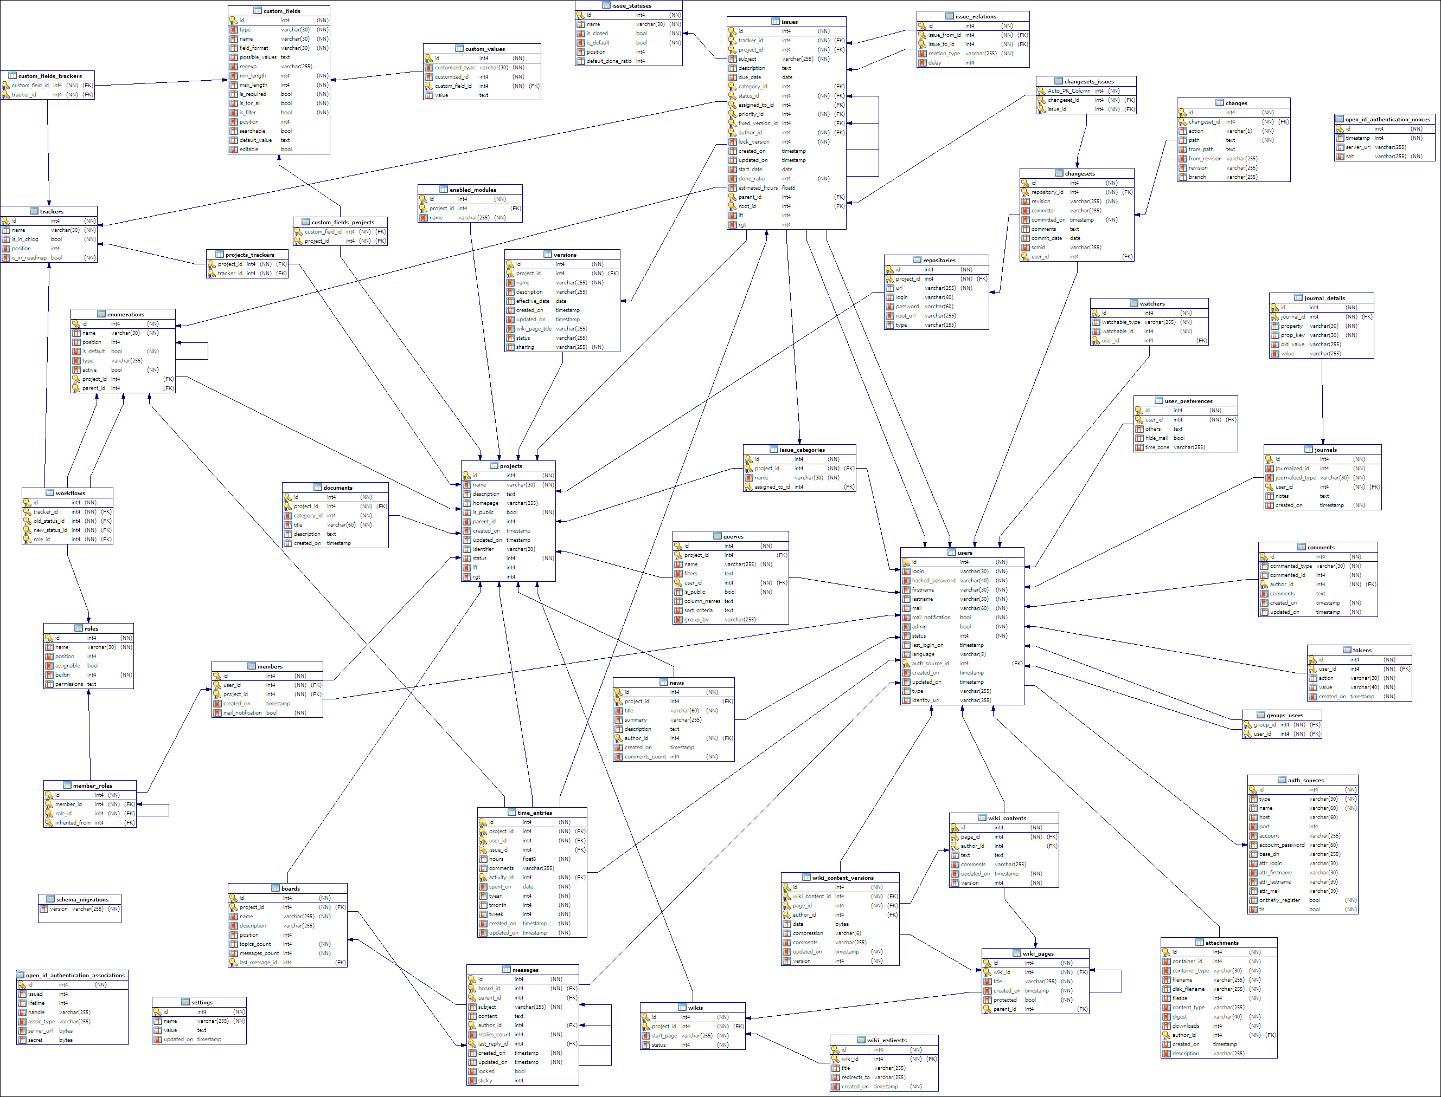
Redmine Database Model

Slide 4
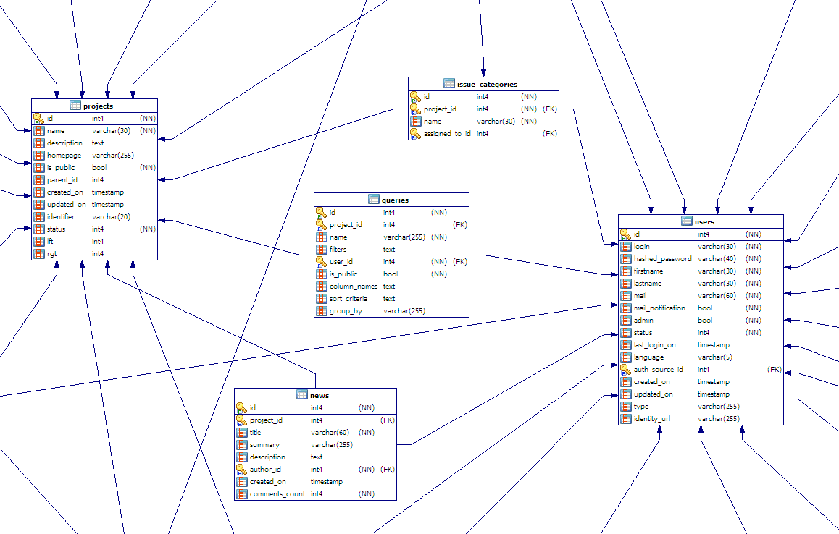

Slide 5

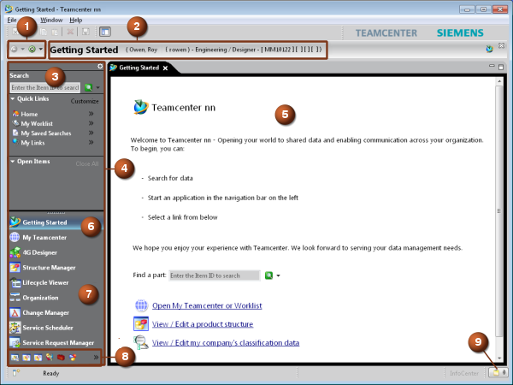
Teamcenter
Teamcenter is a suite of product lifecycle management (PLM) computer software applications.

Slide 6
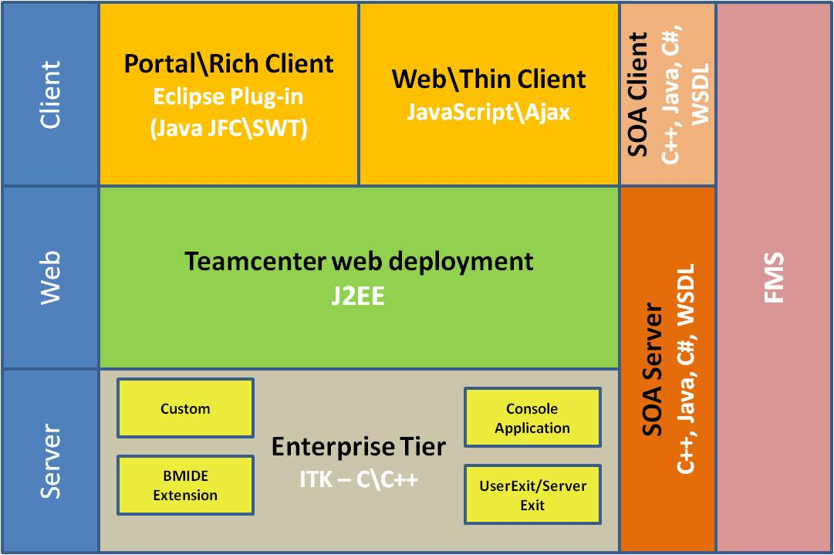
Teamcenter architecture

Slide 7
